Slide 1
Selected Topics on IoT Networking
Time-Slotted Communications

Slide 2
Time-Slotted Communication
Time synchronisation enables time-slotted communication
Time is quantised in time slots, e.g. 10 ms
Communication is based on a repeating schedule
The schedule controls performance
Energy Consumption, e.g. 1/7 = 14% duty cycle
Throughput, e.g. up to 100/7 = 14 frames per sec
Delay, e.g. up to 7 x 10 ms = 70 ms
1 | 2 | 3 | 4 | 5 | 6 | 7
A→B

Slide 3
Contention or Dedicated?
Consider a third device
Dedicated Slots
A
B
C
1 | 2 | 3 | 4 | 5 | 6 | 7
A→B
A’s schedule
1 | 2 | 3 | 4 | 5 | 6 | 7
 | C→B
C’s schedule
Contention-based
1 | 2 | 3 | 4 | 5 | 6 | 7
A→B
A’s schedule
1 | 2 | 3 | 4 | 5 | 6 | 7
C→B
C’s schedule

Slide 4
Wireless Channels
Let’s assume that we have 2 channels
The channel can be a second dimension to my schedule
A
B
C
D
 | 1 | 2 | 3 | 4 | 5 | 6 | 7
Ch 1 | A→B
Ch 2
A’s schedule
 | 1 | 2 | 3 | 4 | 5 | 6 | 7
Ch 1
Ch 2 | C→D
C’s schedule

Slide 5
Channel Hopping
What if a channel in the schedule is a lot busier than another one?
Channel Hopping (or Frequency Hopping)
Transmitter and receiver change channels in a pseudo-random pre-agreed pattern
Hopping Sequence (or pattern)
11 | 26 | 16
1 | 2 | 3 | 4 | 5 | 6 | 7 | 1 | 2 | ...
A→B |  |  |  |  |  |  | A→B
11 | 26 | 16 | 11 | 26 | 16 | 11 | 26 | 16 | 11

Slide 6
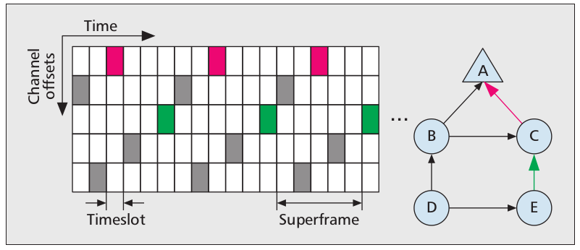
Time-Slotted, Channel Hopping (TSCH)
Part of the IEEE 802.15.4 spec
Synchronous MAC protocol (global synchronisation)
Communication is based on a repeating schedule
Channel is based on a repeating hopping sequence
D. Dujovne, T. Watteyne, X. Vilajosana and P. Thubert, "6TiSCH: deterministic IP-enabled industrial internet (of things)," in IEEE Communications Magazine, vol. 52, no. 12, pp. 36-41, December 2014.

Slide 7
IEEE 802.15.4 TSCH
Advantages
Very reliable - Up to 99.999% PDR reported
Very predictable energy-consumption
Disadvantages
Expensive to join the network
Not great when nodes are mobile
Time-synchronisation challenges (as discussed) remain
Complex implementation
Related standards and other active research
6tisch: 6LoWPAN over TSCH
How schedules are created and distributed
Static, centralised, distributed
How hopping sequences are created and distributed

